Slide 1
Tracking
Chapter 9

Slide 2
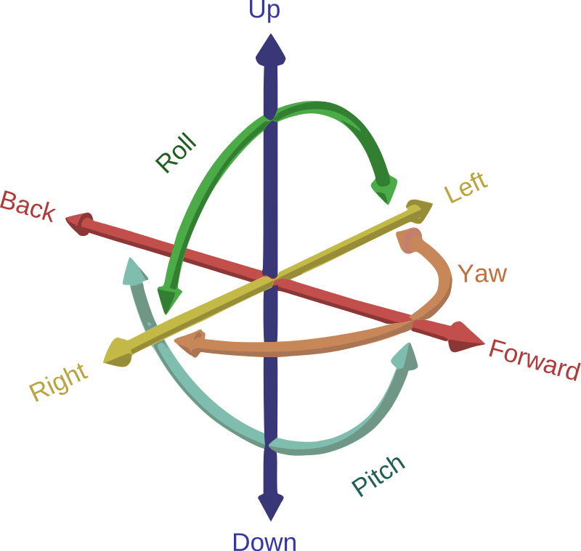
Tracking
The body and component parts have degrees-of-freedom
While the body can translate all the joints are rotation axis’s
In VR applications head tracking has been solved while eye tracking, less so

Slide 3

Tracking Error
Let $\hat{ω}$ be the mesured value of some ω
$\hat{ω}$= a + bω
$\hat{ω}$− ω = a + bω − ω = a + ω(b − 1)
Error vs actual Difference
d(t) = ($\hat{ω}$ − ω)t= (a + bω − ω)t= (a + ω(b − 1))t

Slide 4
Error reduction Solutions
Calibration – using a known state or a better sensor to correct
Integration – samples at intervals lets aggregation with other sensors
Registration – smart default values or initialization process
Drift error – fixed using sensors to detect error and compensate for

Slide 5
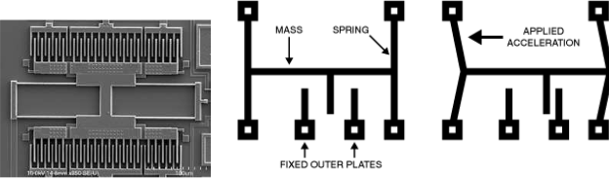
Sensors
Inertial Measurement Unit – once a heavy machine now available as a microscopic chip with 3 axis rotation sensors - they vibrate like a tuning fork and produce an electrical current if force is applied in its axis of sensitivity

Slide 6
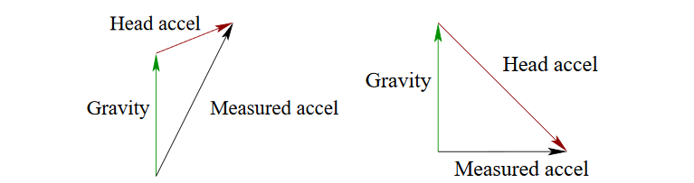
Direction correction and gravity
Finding Up if the sensor isn’t moving up is the opposite of the acceleration due to gravity
Issue is gravity is indistinguishable from normal acceleration In practice only trust the accelerometer if the value is 9.8m/s²

Slide 7
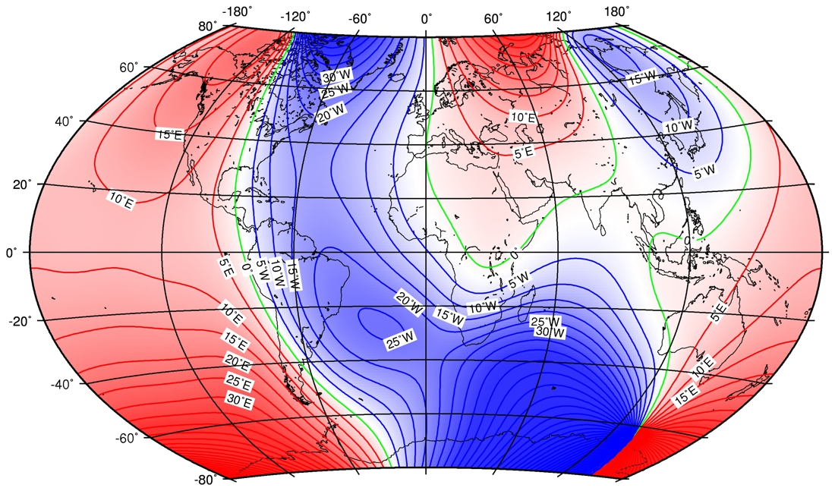
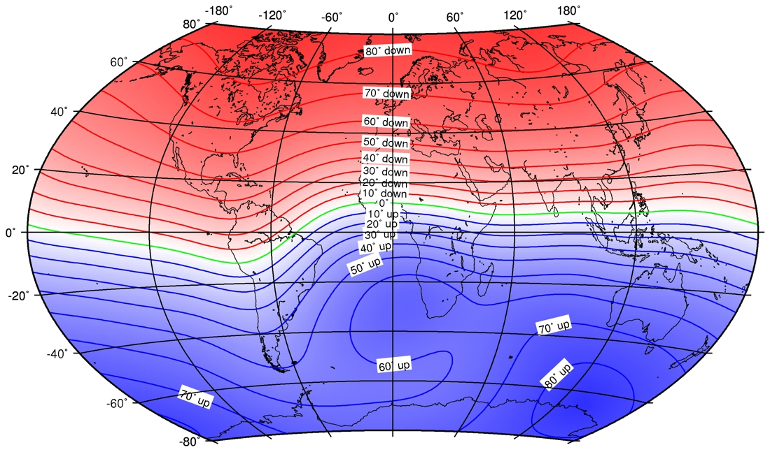
Direction correction and magnetic fields
If location isn’t changing local magnetic fields are relatively constant.
Large metal buildings and other ferromagnetic material will influence the magnetic field as it is a sum of all induced fields

